Slide 1
Envision aCOUGHstics

Slide 2
INTRODUCTION
Covid-19, as everyone knows, is a deadly disease that primarily affects the respiratory system. This disease shut down the world for a few months. However, after the lockdowns around the world were lifted, people have begun to gloss over the existence of covid-19 without realizing that it still exists and is still deadly. Hence there is a need for faster detection of covid-19 so that people can take necessary precautions once they are diagnosed with it.
The idea behind this project is to diagnose covid-19 based on the cough of a person. For this, we take advantage of the difference between a regular cough and the cough of a person infected with covid-19. We find this difference using artificial intelligence, machine learning, audio processing etc.

Slide 3
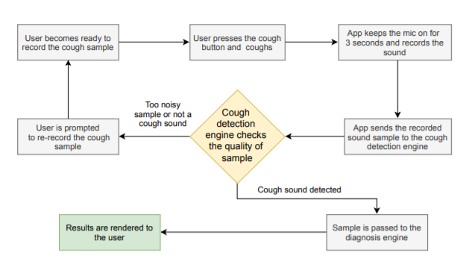
METHOD OF EXECUTION
The recorded cough sample is forwarded to a server where the cough detector engine first computes its Mel-spectrogram
The resultant image is then fed into our Convolutional Neural Network (CNN) based classifier to decide whether the recorded input sound is of cough or not.
When the input sound is detected to be cough by the cough detection engine, it is forwarded to AI engine to diagnose between COVID-19 and non-COVID-19 coughs.

Slide 4
PROGRESS
Currently we are in the middle of learning phase (which is phase 1 out of 5)
We have had 5 sessions of Python KSS, which brings an end to python KSS
We have had 3 Machine Learning KSS

Slide 5
FURTHER PLANS
Firstly, we’ll ensure that we have met the necessary prerequisites to move on with the project, after which we will comprehensively study the data in order to determine the best possible method of implementation.
Finally, we will implement and put the model through various tests in order to increase its accuracy of covid detection.
In the future we may present the model through user-friendly software applications.

Slide 6
THANK YOU

